Slide 1

DEPARTMENT OF ELECTRONICS AND COMMUNICTION ENGINEERING
MARKET BASKET INSIGHTS
TEAM MEMBERS:
S KEERTHANA(113321106091) SNEHA J(113321106092) SUMITHRA K(11332106098) VARSHINI S R(113321106110)
YESHWANTIKAA V M(113321106119)

Slide 2
PROBLEM DEFINITION
The Market Basket Insights problem is a data analysis and
machine learning problem commonly encountered in retail and
e-commerce industries. It involves analyzing customer purchase
data to discover patterns, associations, and insights that can be
used to improve various aspects of business operations,
including marketing, inventory management, and customer
experience. Here is a more detailed problem definition:
Problem: Given a dataset of customer transactions, where each
transaction consists of a list of items purchased by a customer,
the Market Basket Insights problem aims to uncover meaningful relationships, associations, and patterns among these items. The
goal is to gain insights into customer behavior and preferences,
as well as to identify opportunities for business improvement.

Slide 3
OBJECTIVES
The objectives of the Market Basket Insights are given below:
1. Association Rule Mining: Discover frequent itemsets and generate association rules
that reveal which items are often purchased together. Association rules typically consist
of an antecedent (items in the basket) and a consequent (item likely to be purchased
next).
2. Recommendation: Use association rules and collaborative filtering techniques to make
product recommendations to customers based on their purchase history and the
purchasing behavior of similar customers.
Market Basket Analysis: Analyze the performance of product bundles, discounts, and
promotions by examining how items are grouped in customer transactions and how they influence each other's sales.
Inventory Management: Optimize inventory levels by identifying items that are
frequently purchased together or exhibit seasonal trends. This can help reduce stockouts and overstock situations.
Customer Segmentation: Segment customers based on their purchase patterns, allowing for targeted marketing campaigns and personalized offers.

Slide 4
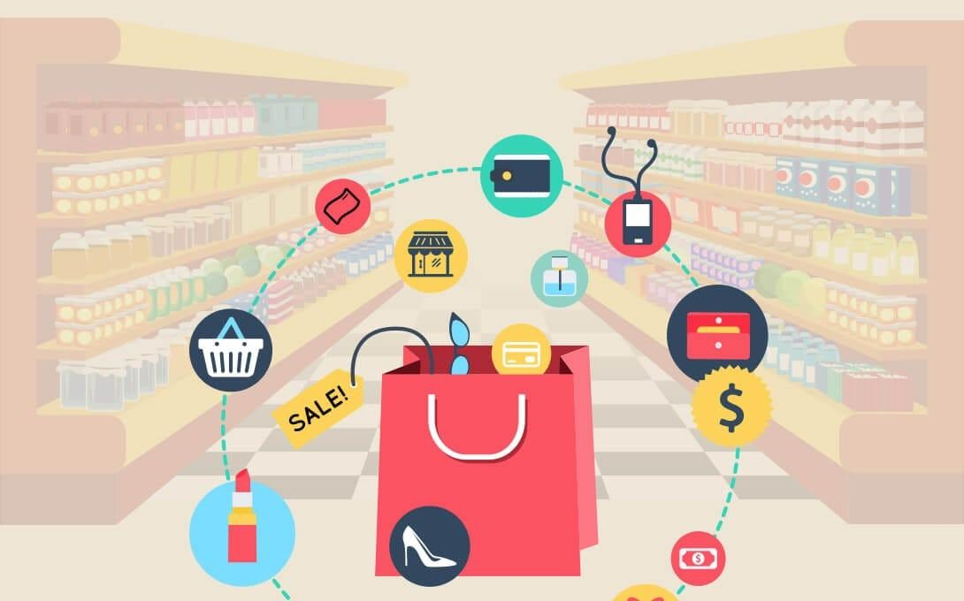
MARKET BASKET ANALYSIS

Slide 5
METHODS AND TECHNIQUES
1. Apriori Algorithm: A popular algorithm for mining frequent itemsets and generating association rules.
2. Collaborative Filtering: Recommending products to customers based on
the behavior and preferences of similar customers.
3. Clustering Algorithms: Group customers into clusters with similar
purchase patterns to enable targeted marketing and product recommendations.
4. Time Series Analysis: Analyze sales data over time to detect seasonality
and trends in item purchases.
5. Visualization: Use data visualization techniques such as heatmaps,
network graphs, and scatter plots to represent and interpret the discovered associations and patterns.
6. Machine Learning: Apply machine learning models for predicting
customer behavior, such as predicting which products a customer is likely
to buy next.

Slide 6
REAL-TIME TRANSIT INFORMATION PLATFORM:
A real-time transit information platform for Market Basket Insights is a data-driven system that continuously collects and analyzes customer transaction data as it occurs, providing immediate and actionable insights to optimize retail operations. This platform integrates
point-of-sale data, inventory management, and customer behavior analysis to generate live reports and recommendations.
It tracks customer purchases in real time, identifies patterns, predicts future shopping behaviors, and dynamically adjusts marketing strategies, product placements, and inventory levels to enhance sales, reduce stockouts, and improve the overall shopping experience, all while adapting to changing customer preferences and market trends in real-time, enabling retailers to make informed decisions and maximize their profitability.

Slide 7
INTEGRATION APPROACH
The integration approach for Market Basket Insights involves seamlessly combining various data sources, analytical techniques, and technologies to derive valuable insights from customer transaction data. First, data sources such as point-of-sale systems, e-commerce platforms, and customer databases need to be integrated into a centralized data repository. This repository should support real-time data ingestion and processing to ensure that insights are up-to-date.
Next, advanced analytics and data mining tools, such as association rule mining algorithms like Apriori, machine learning models for customer segmentation and recommendation systems, and visualization tools, should be integrated into the data pipeline.
Finally, the insights generated should be seamlessly integrated into the decision-making processes of the organization, informing marketing campaigns, inventory management strategies, and product recommendations in real time. This holistic integration approach empowers businesses to leverage data-driven insights to optimize operations, enhance customer experiences, and drive revenue growth.

Slide 8
INTEGRATION BENEFITS
Market Basket Insights provide numerous benefits for businesses, particularly in
the retail and e-commerce sectors. Here are some key advantages:
1. Improved Customer Experience: By understanding customer preferences and purchasing
patterns, businesses can provide more personalized shopping experiences. This includes offering
tailored product recommendations and promotions, ultimately leading to increased customer satisfaction.
2. Increased Sales: Market Basket Insights can uncover cross-selling and upselling opportunities.
By recommending related or complementary products, businesses can boost their average transaction value and overall revenue.
3. Fraud Detection: Market Basket Insights can also be used for fraud detection. Unusual or
unexpected item combinations in transactions can raise red flags for potential fraudulent
activities.
4. Competitive Advantage: Leveraging market basket insights provides a competitive edge.
Businesses that can better understand and cater to customer needs are more likely to thrive in a
crowded marketplace.
Data-Driven Decision-Making: Businesses can make informed decisions based on data rather than intuition, reducing risks and uncertainty in their strategies.
Customer Loyalty: By offering personalized recommendations and improving the overall shopping experience, businesses can build stronger customer loyalty and retention.

Slide 9
CONCLUSION
In conclusion, Market Basket Insights represent a pivotal tool in
the arsenal of modern businesses, particularly those in the retail
and e-commerce sectors. The ability to extract actionable
intelligence from customer transaction data is a game-changer,
offering a multitude of benefits ranging from enhanced customer
experiences and increased sales to more efficient inventory
management and targeted marketing. By leveraging data
analytics, machine learning, and real-time processing, businesses can gain a competitive edge in a rapidly evolving marketplace.
Market Basket Insights not only illuminate customer preferences
and behaviors but also empower organizations to make
data-driven decisions, adapt to changing market dynamics, and
ultimately thrive in an era where understanding and meeting
customer needs is paramount.

Slide 10
THANK YOU

Slide 11


